Slide 1
Wireframe-Based Pothole Detection and Avoidance System
BATCH - 02
Guided by: Dr SURESH KUMAR
Presented by MOHAMED B SIRAJUDDEEN (22TD0053)

Slide 2
Domain & Sub-Domain
Artificial Intelligence
Autonomous Vehicles
Focuses on building systems that mimic human intelligence.
Involves machine learning, deep learning, computer vision, and decision-making.
Enables machines to perceive, learn, adapt, and take actions autonomously.
Key techniques used in this project:
Object Detection (YOLOv8)
Monocular Depth Estimation (MiDaS)
3D Reconstruction (Open3D)
Rule-Based Decision Systems
Applies AI techniques to enable self-driving or driver-assistive vehicles.
Combines perception, localization, path planning, and control.
Addresses real-time environmental sensing and decision-making for safe navigation.
Specific focus in this project:
Real-time road surface anomaly detection
Depth-aware vehicle behavior (slow, avoid, alert)
Low-cost AV sensor alternatives for developing regions
Camera-based road understanding for poor infrastructure

Slide 3
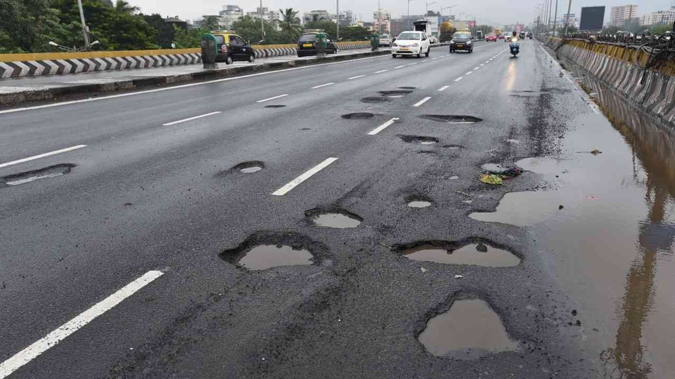
Problem Statement
Introduction
Autonomous vehicles (AVs) rely on object detection and navigation systems optimized for structured and well-maintained roads.
In countries like India, road infrastructure is often inconsistent, featuring frequent potholes, speed bumps, and surface deformities.
Standard AV systems struggle to operate reliably in such conditions, impacting safety and ride quality.
Surface anomalies reduce ride comfort and can be significant safety hazards.
Conventional solutions using LiDAR and high-end sensors are expensive and not suitable for mass deployment.
There is a pressing need for a cost-effective, camera-based solution capable of detecting, analyzing, and responding to road surface anomalies in real-time.

Slide 4
Project Objective
To design a vision-based pothole detection system using only a monocular camera, eliminating the need for LiDAR or stereo vision.
To implement YOLOv8 for accurate detection of road surface anomalies such as potholes and speed breakers.
To utilize MiDaS for monocular depth estimation, generating a pixel-wise depth map from a single camera frame.
To develop a wireframe mesh of the road surface using Open3D for real-time 3D reconstruction and analysis.
To estimate the size, depth, and severity of detected road anomalies based on wireframe geometry.
To create a decision engine that enables autonomous vehicle behavior such as slowing down, stopping, or avoiding hazardous road conditions.
To ensure the system is lightweight, low-cost, and deployable on embedded platforms such as Raspberry Pi or Jetson Nano.
To make the system suitable for real-world conditions, especially in developing countries like India with irregular road infrastructure.

Slide 5
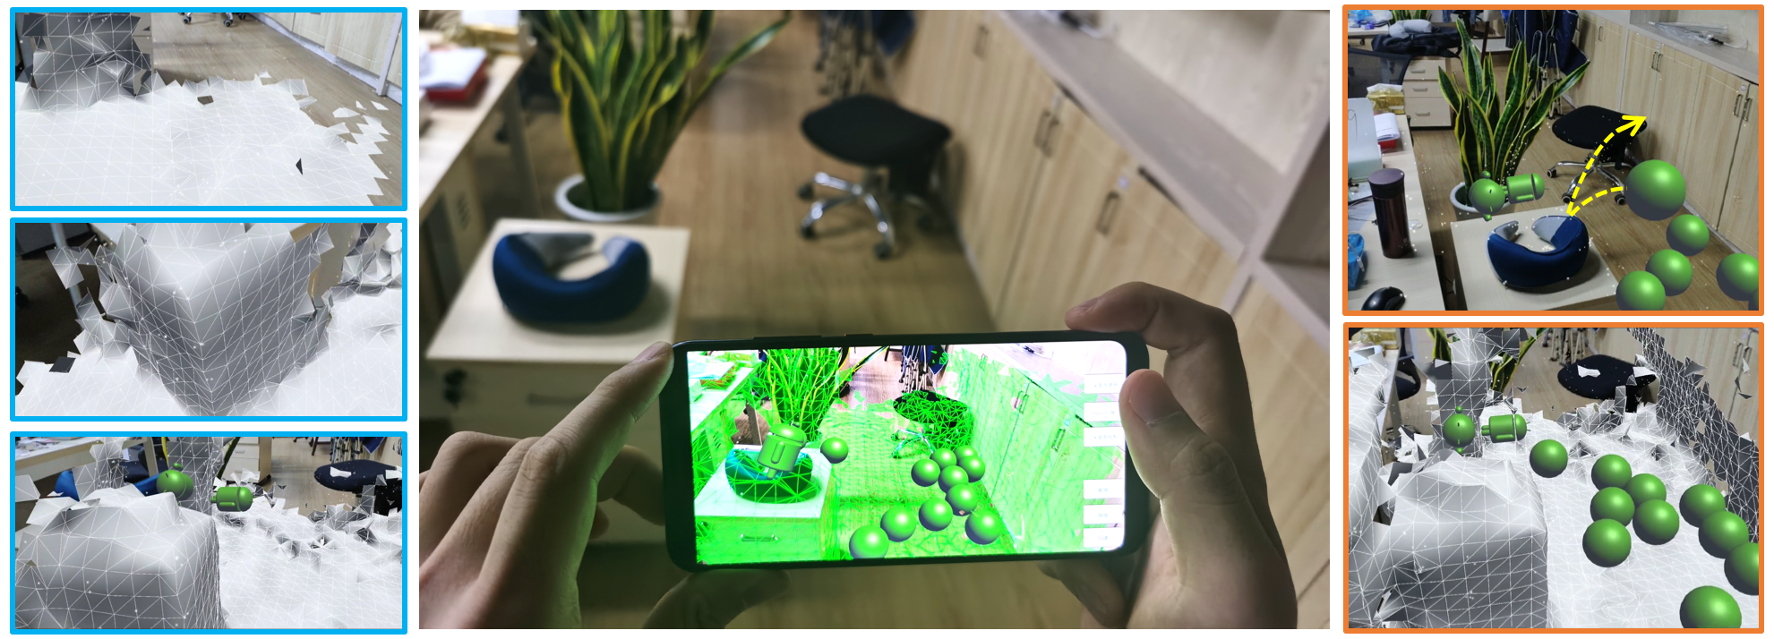
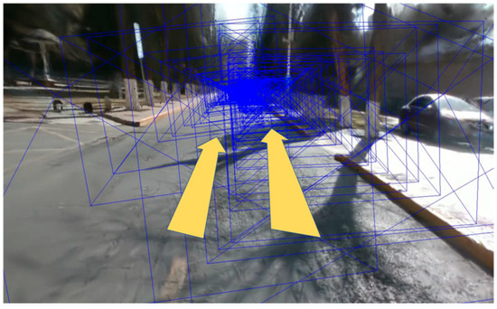
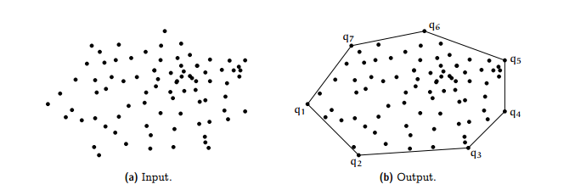
Existing Work in Pothole Detection
YOLO-based detection (YOLOv5, YOLOv8)
LiDAR + Camera fusion for accurate depth
Point cloud and Convex Hull for geometry
Mobile3DRecon – real-time monocular mesh
RoGs – road-specific Gaussian surfel reconstruction

Slide 6
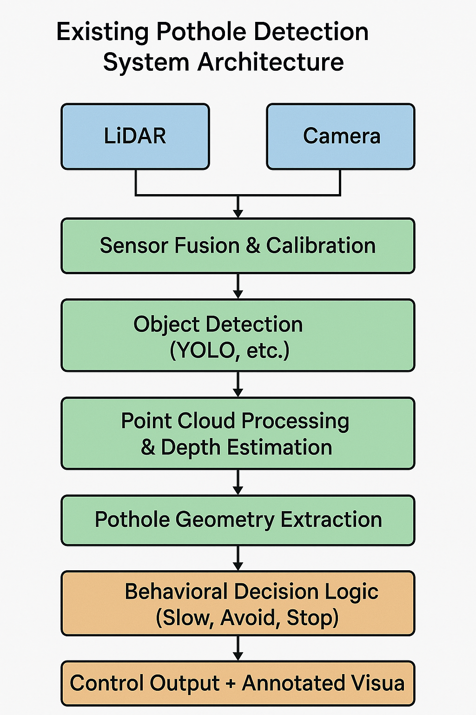
Architectural Structure

Slide 7
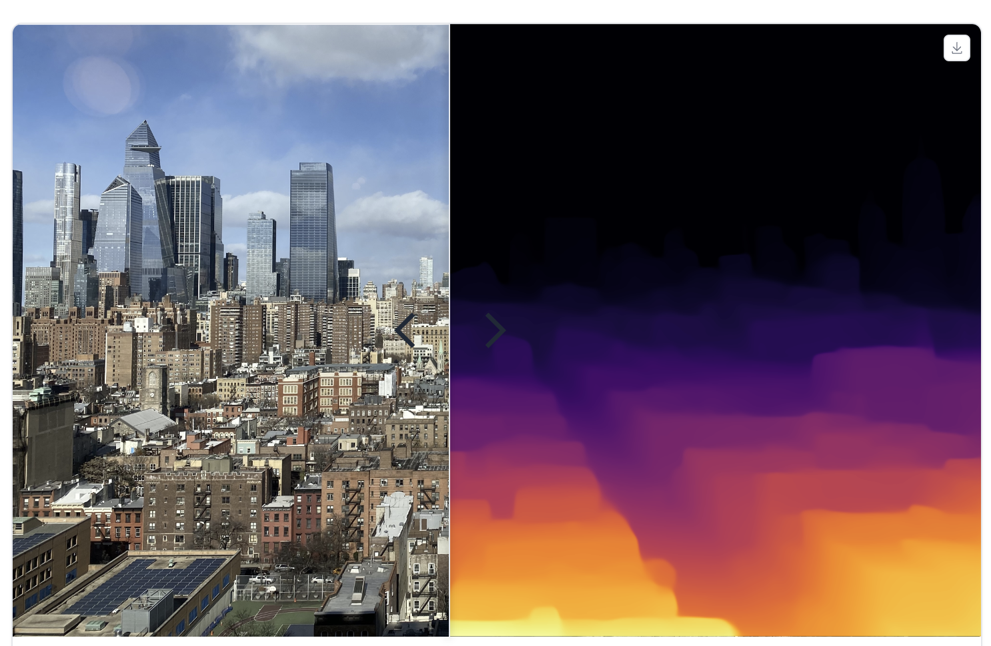

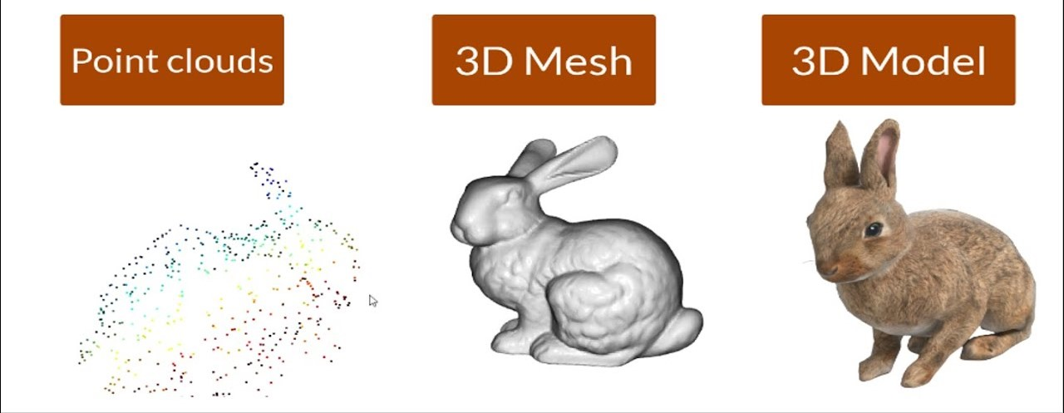
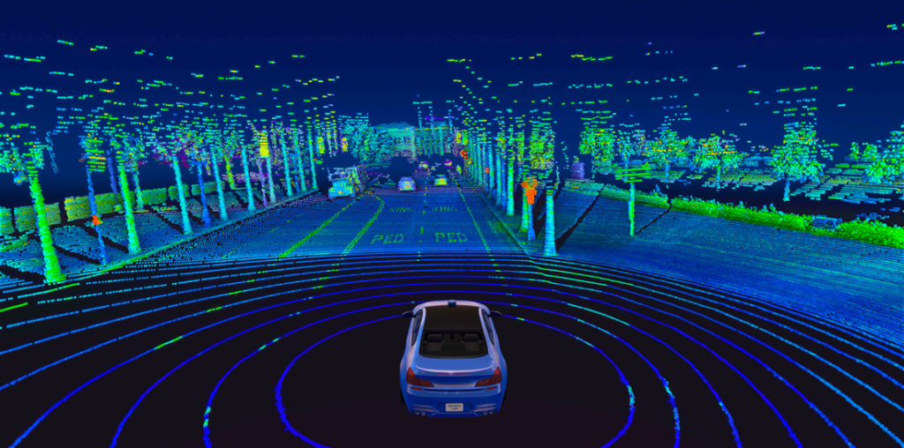
MiDaS
LiDAR
Open3D

Slide 8
Literature Survey
Paper 1: Demonstrates combining segmentation and depth to calculate pothole area and depth from dashboard camera footage — similar to YOLO + MiDaS method for depth-aware characterization.
Paper 2: Provides a baseline for depth‑enabled segmentation — your camera‑only system replaces depth sensor with MiDaS-based depth estimation.
Paper 3: Validates feasibility of estimating metric depth and segmentation from a single image — supports your monocular depth + segmentation pipeline.

Slide 9
Literature Survey Table Comparison
Paper | Technology | Conclusion
Enhancing Pothole Detection and Characterization: Integrated Segmentation and Depth Estimation in Road Anomaly Systems - 2025 | YOLOv8‑seg + monocular depth integration | Validates method of merging segmentation with depth maps
An Enhanced YOLOv8 Model for Real‑Time and Accurate Pothole Detection and Measurement - 2025 | YOLOv8n‑seg enhanced with DSConv, SimAM, GELU + RGB‑D dataset | Guides improving detection performance
Deep Learning based Pothole Monocular Depth Estimation and Segmentation Using 3D Scanner‑Derived Depth Maps - 2023 | Modified 3DPredicNet for depth estimation and segmentation using DSLR images and ground‑truth 3D scans | Supports feasibility of camera-only depth segmentation

Slide 10
Current Status of the Project
Research paper review in progress
Technology identification and research in progress
Preparing prerequisites for Model Training

Slide 11
Conclusion
Estimated Low-cost of Prototype AVs, real-time pothole detection system
Combines vision, depth, mesh & AV logic
Assumed to be optimized for real-world road safety in India
Strong potential for AV deployment in India

Slide 12
Thank You

